Slide 1

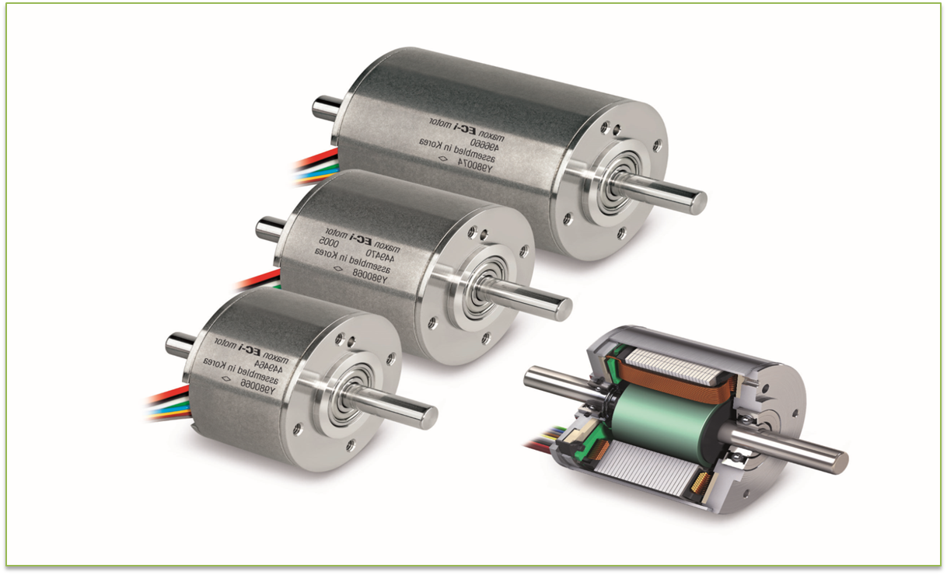

Slide 2
Electric Motors
Introduction
DC Motors
AC Motors
Synchronous Motors
Induction Motors
Conclusion

Slide 3
Introduction
In this lecture we consider various forms of rotating electrical machines
These can be divided into:
generators – which convert mechanical energy into electrical energy
motors – which convert electrical energy into mechanical energy
Both types operate through the interaction between a magnetic field and a set of windings

Slide 4
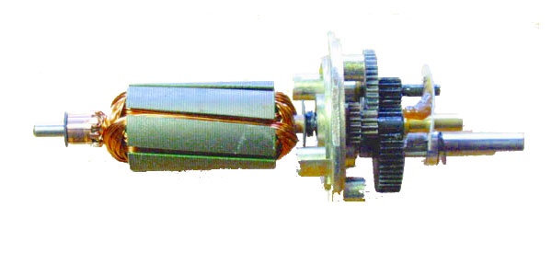
DC Motors
A DC Motor is a very simple electric motor which is operated on direct current (DC). The DC Motor moves due to the torque generated by the electro-magnetic field. A simple DC Motor uses electric coil and magnets of opposite polarity. As the magnets with opposite poles attracts and repels one another, a DC Motor turns. The electric coil used in a DC Motor acts as an electromagnet

Slide 5
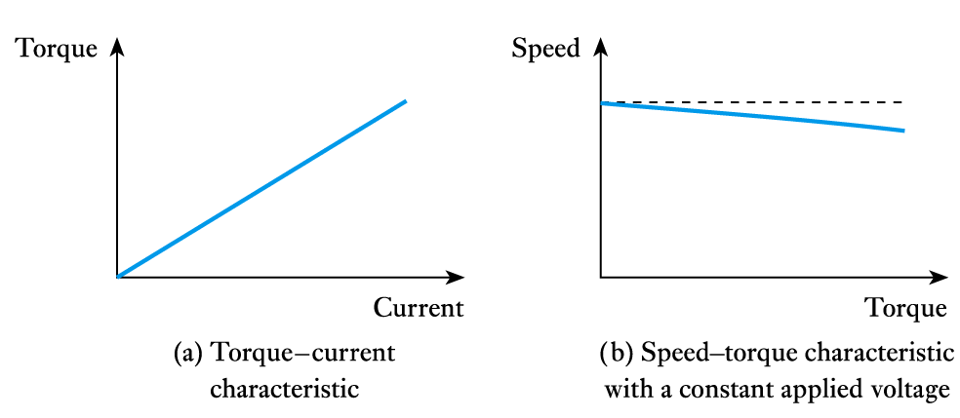
DC motor characteristics
many forms – each with slightly different characteristics
again can be permanent magnet, or series-wound, shunt-wound or compound wound
figure below shows a shunt-wound DC motor

Slide 6
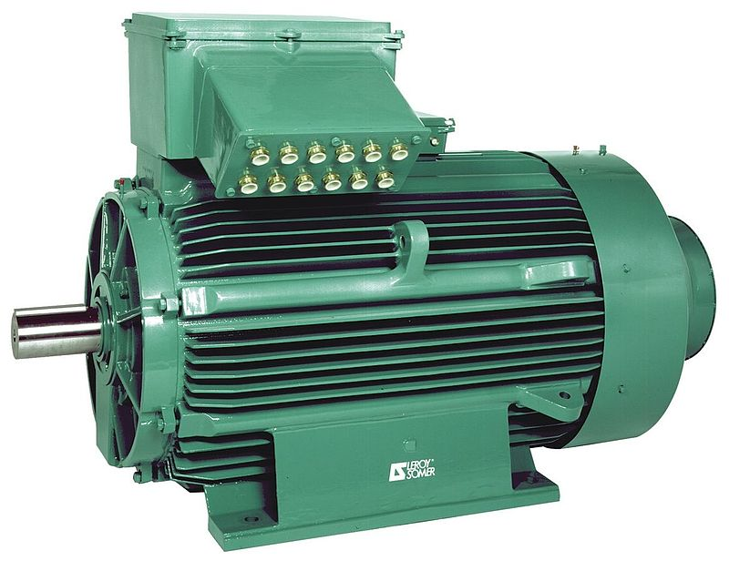
AC Motors
An AC motor is an electric motor driven by an alternating current (AC). The AC motor commonly consists of two basic parts, an outside stationary stator having coils supplied with alternating current to produce a rotating magnetic field, and an inside rotor attached to the output shaft producing a second rotating magnetic field.
AC motors can be divided into two main forms:
synchronous motors
induction motors

Slide 7
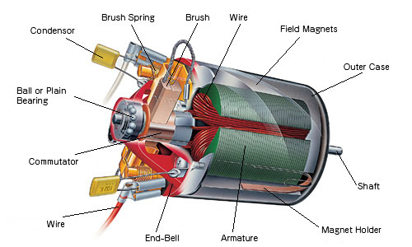
Synchronous motors
just as a DC generator can be used as a DC motor, so AC generators (or alternators) can be used as synchronous AC motors
three phase motors use three sets of stator coils
the rotating magnetic field drags the rotor around with it
single phase motors require some starting mechanism
torque is only produced when the rotor is in sync with the rotating magnetic field

Slide 8
Induction motors
these are perhaps the most important form of AC motor
rather than use slip rings to pass current to the field coils in the rotor, current is induced in the rotor by transformer action
the stator is similar to that in a synchronous motor
the rotor is simply a set of parallel conductors shorted together at either end by two conducting rings

Slide 9
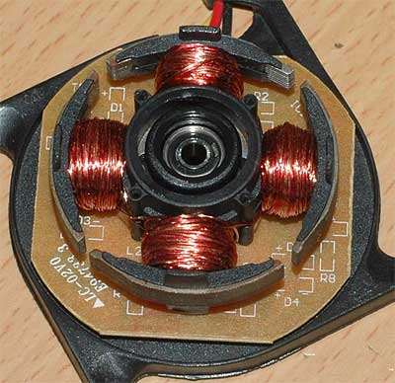
Both DC and AC motors are used
high-power motors are usually AC, three-phase
domestic applications often use single-phase induction motors
DC motors are useful in control applications

Slide 10
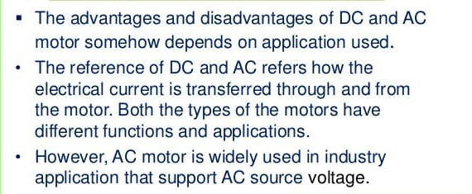
Conclusion

Slide 11
THANK YOU

